Slide 1

Graph Algorithms
Mathematical Structures for Computer Science
Chapter 7
Copyright © 2014 W.H. Freeman & Co. MSCS Slides Section 7.3

Slide 2
Shortest Path Problem
Assume that we have a simple, weighted, connected graph, where the weights are positive. Then a path exists between any two nodes x and y.
How do we find a path with minimum weight?
For example, cities connected by roads, with the weight being the distance between them.
The shortest-path algorithm is known as Dijkstra’s algorithm.
Section 7.3
Shortest Path and Minimal Spanning Tree

Slide 3
Shortest-Path Algorithm
To compute the shortest path from x to y using Dijkstra’s algorithm, we build a set (called IN ) that initially contains only x but grows as the algorithm proceeds.
IN contains every node whose shortest path from x, using only nodes in IN, has so far been determined.
For every node z outside IN, we keep track of the shortest distance d[z] from x to that node, using a path whose only non-IN node is z.
We also keep track of the node adjacent to z on this path, s[z].
Section 7.3
Shortest Path and Minimal Spanning Tree

Slide 4
Shortest-Path Algorithm
Pick the non-IN node p with the smallest distance d.
Add p to IN, then re-compute d for all the remaining non-IN nodes, because there may be a shorter path from x going through p than there was before p belonged to IN.
If there is a shorter path, update s[z] so that p is now shown to be the node adjacent to z on the current shortest path.
As soon as y is moved into IN, IN stops growing.
  The current value of d[y] is the distance for the shortest path
  And its nodes are found by looking at y, s[y], s[s[y]], and so forth, until x is reached.
Section 7.3
Shortest Path and Minimal Spanning Tree

Slide 5
Shortest-Path Algorithm
ALGORITHM ShortestPath
ShortestPath (n × n matrix A; nodes x, y)
//Dijkstra’s algorithm. A is a modified adjacency matrix for a
//simple, connected graph with positive weights; x and y are
//nodes in the graph; writes out nodes in the shortest path from x
// to y, and the distance for that path
Local variables:
set of nodes IN //set of nodes whose shortest path from x
//is known
nodes z, p //temporary nodes
array of integers d //for each node, the distance from x using
//nodes in IN
array of nodes s //for each node, the previous node in the
//shortest path
integer OldDistance //distance to compare against
//initialize set IN and arrays d and s
IN = {x}
d[x] = 0
Section 7.3
Shortest Path and Minimal Spanning Tree

Slide 6
Shortest-Path Algorithm
for all nodes z not in IN do
d[z] = A[x, z]
s [z] = x
end for
while y not in IN do //process nodes into IN
//add minimum-distance node not in IN
p = node z not in IN with minimum d[z]
IN = IN ∪ {p}
//recompute d for non-IN nodes, adjust s if necessary
for all nodes z not in IN do
OldDistance = d[z]
d[z] = min(d[z], d[ p] + A[ p, z])
if d[z] ≠ OldDistance then
s [z] = p
end if
end for
end while
d[z], array is filled with the distances from x to each node
Section 7.3
Shortest Path and Minimal Spanning Tree

Slide 7
Shortest-Path Algorithm
//write out path nodes
write(“In reverse order, the path is”)
write (y)
z = y
repeat
write (s [z])
z = s [z]
until z = x
// write out path distance
write(“The path distance is,” d[y])
end ShortestPath
Section 7.3
Shortest Path and Minimal Spanning Tree

Slide 8
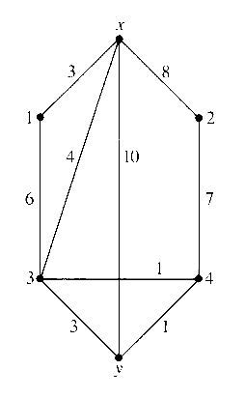
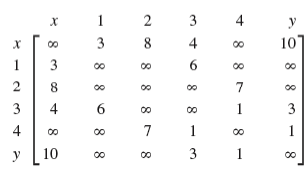
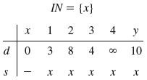
Shortest-Path Algorithm Example
Trace the algorithm using the following graph and adjacency matrix:
At the end of the initialization phase:
Node 4 is not adjacent to node x as shown by ∞
d is always the distance to x
Section 7.3
Shortest Path and Minimal Spanning Tree

Slide 9
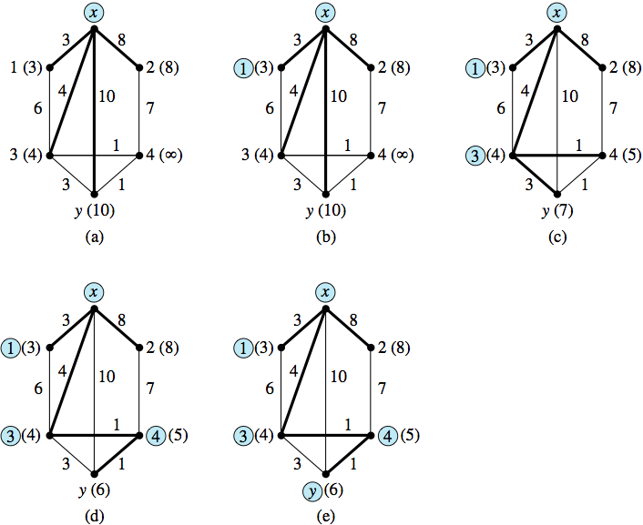
Shortest-Path Algorithm Example
The circled nodes are those in set IN. heavy lines show the current shortest paths, and the d-value for each node is written along with the node label.
Eventually node 1 is eliminated from Set IN and is not part of the shortest path – let’s see how
Section 7.3
Shortest Path and Minimal Spanning Tree

Slide 10
Shortest-Path Algorithm Example
We now enter the while loop and search through the d-values for the node of minimum distance that is not in IN. Node 1 is found, with d[1] = 3.
Node 1 is added to IN. We re-compute all the d-values for the remaining nodes, 2, 3, 4, and y.
p = 1
IN = {x,1}
d[2] = min(8, 3 + A[1, 2]) = min(8, ∞) = 8
d[3] = min(4, 3 + A[1, 3]) = min(4, 9) = 4
d[4] = min(∞, 3 + A[1, 4]) = min(∞, ∞) = ∞
d[y] = min(10, 3 + A[1, y]) = min(10, ∞) = 10
This process is repeated until y is added to IN.
Checks to see, of the remaining adjacent nodes to x outside of node 1, if there is a shorter path; d[?] always checks distant to x from an adjacent node
Section 7.3
Shortest Path and Minimal Spanning Tree

Slide 11

Shortest-Path Algorithm Example
The second pass through the while loop:
  p = 3 (3 has the smallest d-value, namely 4, of 2, 3, 4, or y)
  IN = {x, 1, 3}
  d[2] = min(8, 4 + A[3, 2]) = min(8, 4 + ∞) = 8
  d[4] = min(∞, 4 + A[3, 4]) = min(∞, 4 + 1) = 5 (a change, so update s[4] to 3)
  d[y] = min(10, 4 + A[3, y]) = min(10, 4 + 3) = 7 (a change, so update s[y] to 3)
d is always distant to x
Section 7.3
Shortest Path and Minimal Spanning Tree

Slide 12

Shortest-Path Algorithm Example
The third pass through the while loop:
  p = 4 (d-value 5)
  IN = {x, 1, 3, 4}
  d[2] = min(8, 5 + 7) = 8
  d[y] = min(7, 5 + 1) = 6 (a change, update s[y])
d is always distant to x
Section 7.3
Shortest Path and Minimal Spanning Tree

Slide 13

Shortest-Path Algorithm Example
The third pass through the while loop:
  p = y
  IN = {x, 1, 3, 4, y}
  d[2] = min(8, 6 + ∞) = 8
y is now part of IN, so the while loop terminates. The (reversed) path goes through y, s[y]= 4, s[4]= 3, and s[3] = x.
Section 7.3
Shortest Path and Minimal Spanning Tree

Slide 14
Shortest-Path Algorithm Analysis
ShortestPath is a greedy algorithm - it does what seems best based on its limited immediate knowledge.
The for loop requires Θ(n) operations.
The while loop takes Θ(n) operations.
In the worst case, y is the last node brought into IN, and the while loop will be executed n - 1 times.
The total number of operations involved in the while loop is Θ(n(n - 1)) = Θ(n² ).
Initialization and writing the output together take Θ(n) operations.
So the algorithm requires Θ(n + n²) = Θ(n² ) operations in the worst case.
Section 7.3
Shortest Path and Minimal Spanning Tree

Slide 15
Minimal Spanning Tree Problem
DEFINITION: SPANNING TREE
A spanning tree for a connected graph is a nonrooted tree whose set of nodes coincides with the set of nodes for the graph and whose arcs are (some of) the arcs of the graph.
A spanning tree connects all the nodes of a graph with no excess arcs (no cycles). There are algorithms for constructing a minimal spanning tree, a spanning tree with minimal weight, for a given simple, weighted, connected graph.
Prim’s Algorithm proceeds very much like the shortest-path algorithm, resulting in a minimal spanning tree.
Section 7.3
Shortest Path and Minimal Spanning Tree

Slide 16
Prim’s Algorithm
There is a set IN, which initially contains one arbitrary node.
For every node z not in IN, we keep track of the shortest distance d[z] between z and any node in IN.
We successively add nodes to IN, where the next node added is one that is not in IN and whose distance d[z] is minimal.
The arc having this minimal distance is then made part of the spanning tree.
The minimal spanning tree of a graph may not be unique.
The algorithm terminates when all nodes of the graph are in IN.
The difference between Prim’s and Dijkstra’s algorithm is how d[z] (new distances) are calculated.
Dijkstra’s: d[z] = min(d[z], d[p] + A[ p, z])
Prim’s: d[z] = min(d[z], A[ p, z]))
Section 7.3
Shortest Path and Minimal Spanning Tree

